Slide 1
C PROGRAMMING
Union

Slide 2
What is a union?
Unions are conceptually similar to structures in C.
The syntax to declare/define a union is also similar to that of a structure.
The only differences is in terms of storage.
In structure each member has it’s own storage location, whereas all members of union uses a single shared memory location which is equal to the size of its largest data member.
Although a union may contain many members of different types, it cannot handle all the members at the same time.

Slide 3
Declaring a Union
A union is declared using the union keyword.
Syntax –
union tag_name
{
member definition;
member definition;
...
member definition;
};

Slide 4
Declaring a Union
Example–
union item
{
int m;
float x;
char c;
}
This union contains three members each with a different data type. However only one of them can be used at a time.
This is due to the fact that only one location is allocated for all the union variables, irrespective of their size.
The compiler allocates the storage that is large enough to hold the largest variable type in the union.

Slide 5
Accessing a Union Member
We use member access operator (.) to access members of a union.
It is used between the union variable name and the union member that we want to access.
Syntax for accessing any union member is similar to accessing structure members.
Example-
union test
{
int a;
float b;
char c;
} t;
t.a; //to access members of union t
t.b;
t.c;
In unions, if we change the value of any one member, the value of other members gets affected.

Slide 6
Difference Between Structure and Union
In union, we can only initialize the first data member whereas in a structure, we can initialize many data members at once.
Compiler allocates memory for each member of a structure while for a union, it allocates memory equal to the size of the largest data member.
Union members share a memory location while structure members have a unique storage location each.
In a structure, we can access individual members simultaneously while in a union, we can only access one member at a time.
If we change the value of a member in a structure, it won't affect its other members but in a union, changing the value of one member will affect the others.

Slide 7
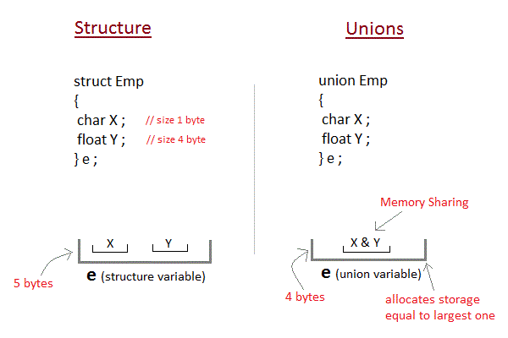
Difference between Structure and Union

